Slide 1
Graph Algorithms
Siam Sharif Ami
Lecturer IIUC

Slide 2
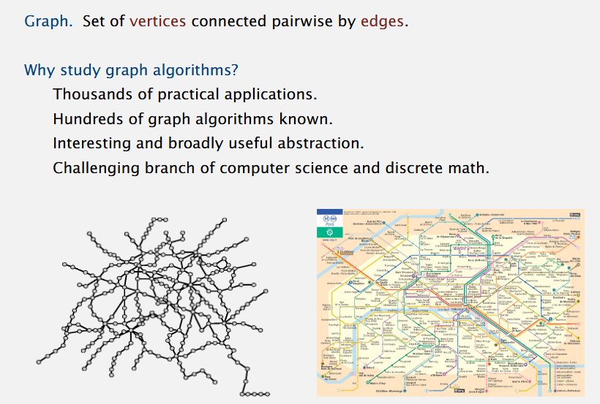

Slide 3
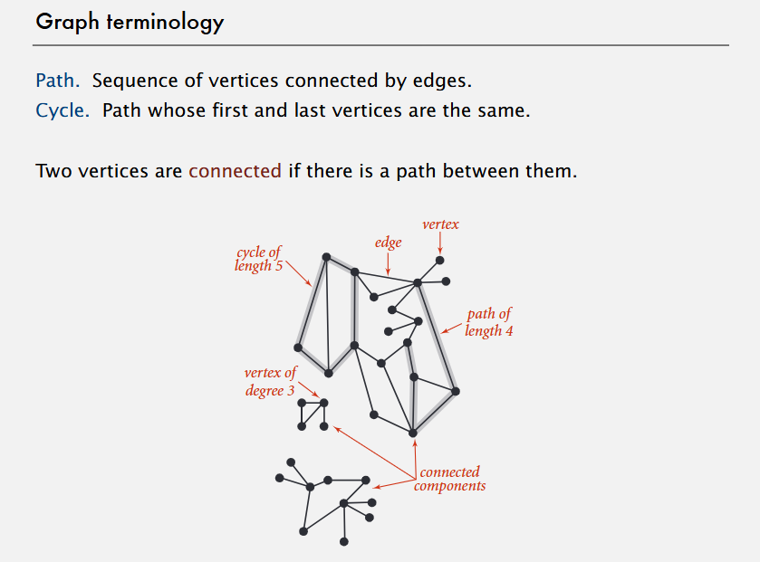

Slide 4
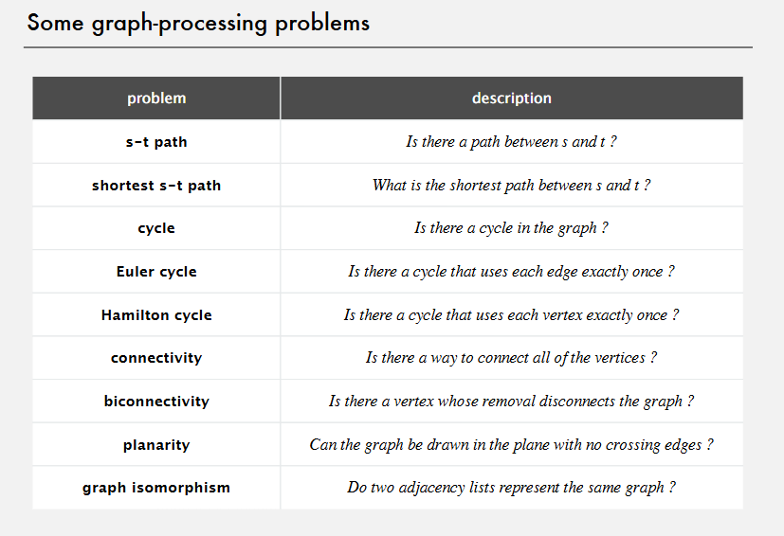

Slide 5
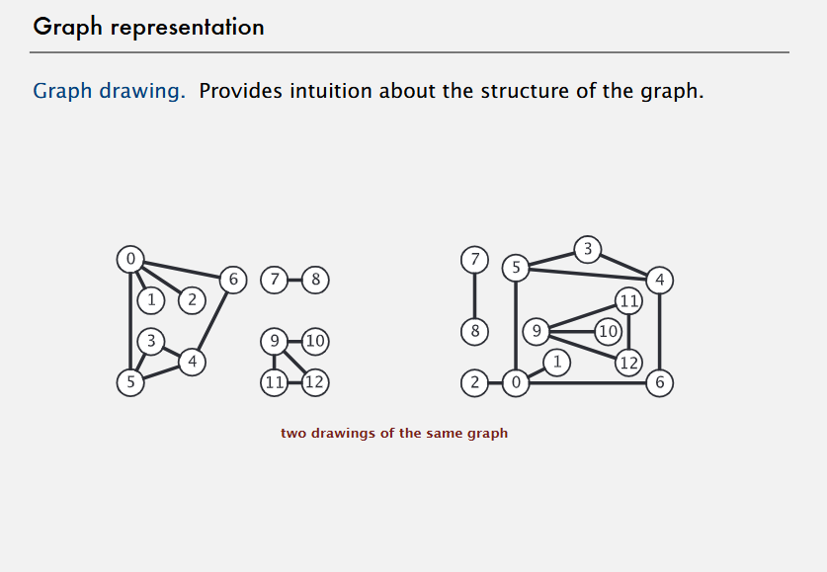

Slide 6
Types of Graphs

Slide 7
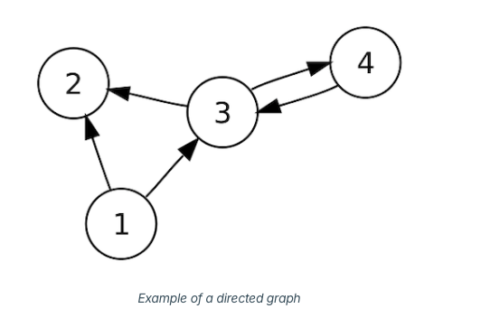
Directed Graph
In directed graphs, the edges direct the path that must be taken to travel between connected nodes. The edges are typically represented as arrows.

Slide 8
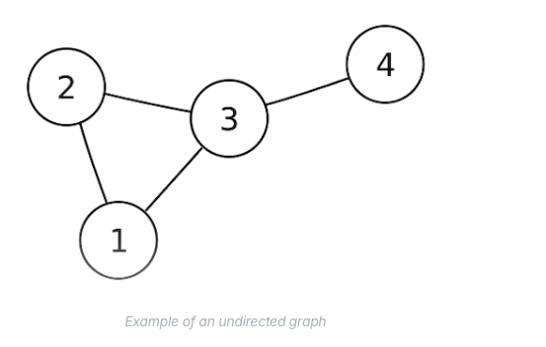
Undirected Graph
Undirected graphs do not show the direction which must be taken between nodes. Instead, travel between nodes is allowd along an edge in either direction. There are no loops or multiple edges in undirected graphs.

Slide 9
Graph Representation

Slide 10
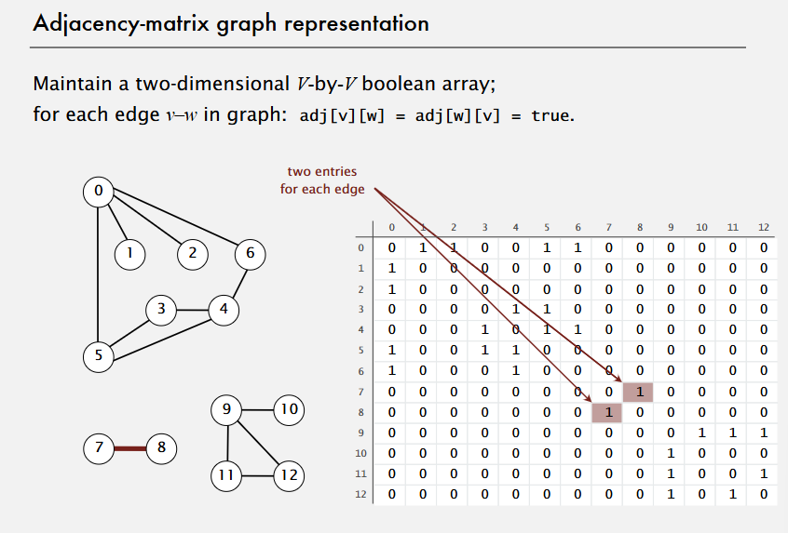

Slide 11
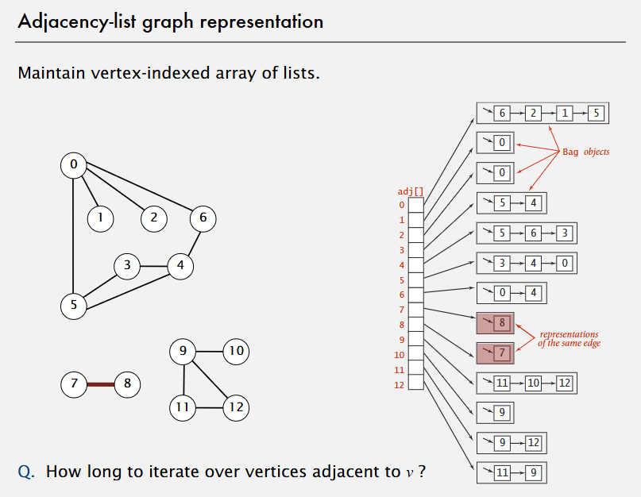

Slide 12
Graph Traversal

Slide 13
Breadth First Search
Breadth First Search (BFS) is a fundamental graph traversal algorithm. It begins with a node, then first traverses all its adjacent nodes. Once all adjacent are visited, then their adjacent are traversed.

Slide 14
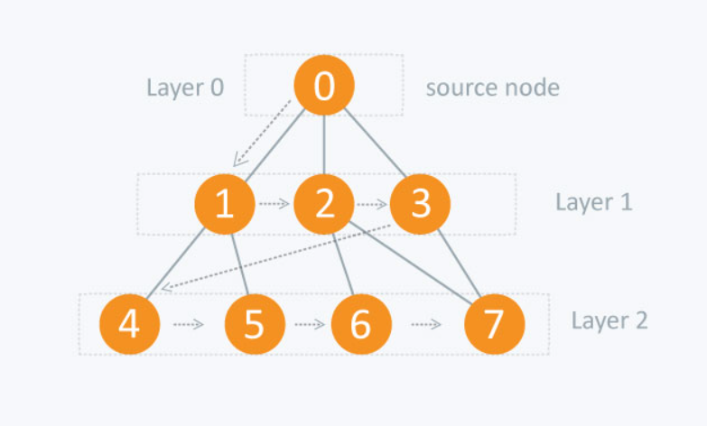

Slide 15
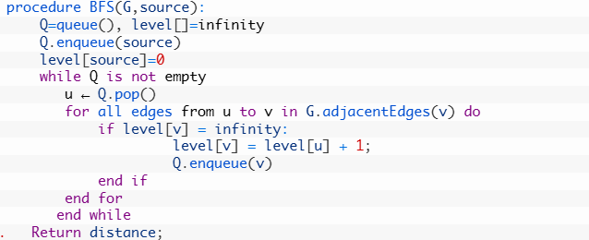
BFS Algorithm

Slide 17
Topological Sorting

Slide 18
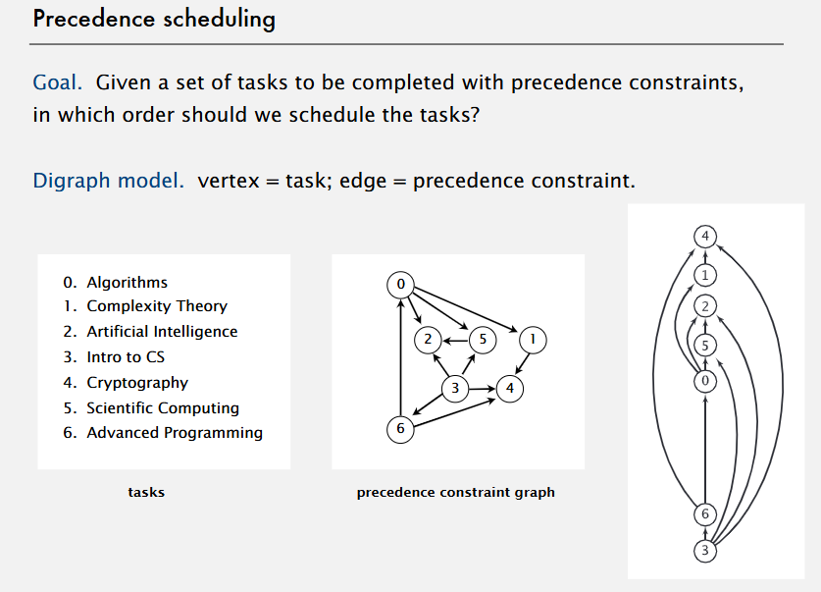

Slide 19
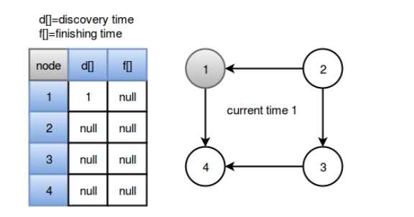
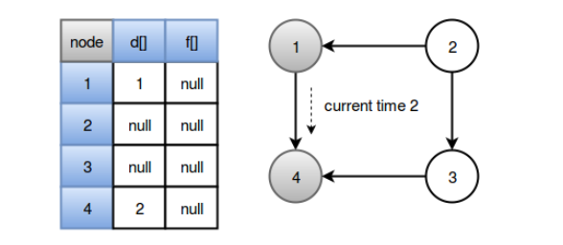

Slide 20
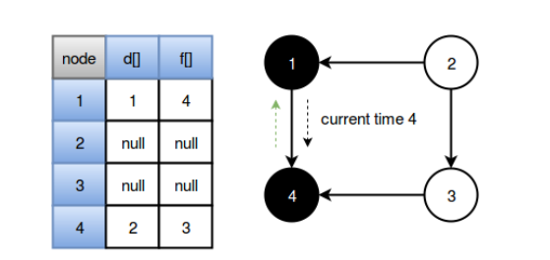
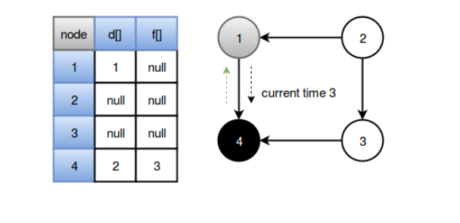

Slide 21
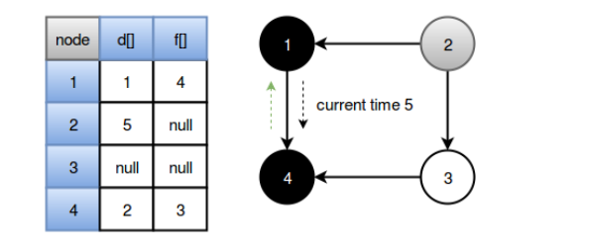
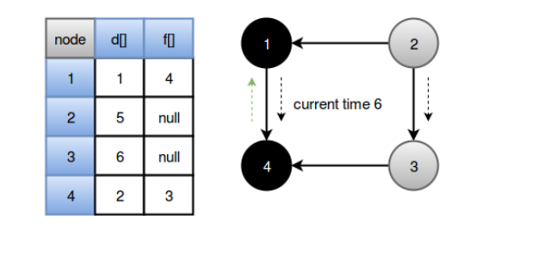

Slide 22
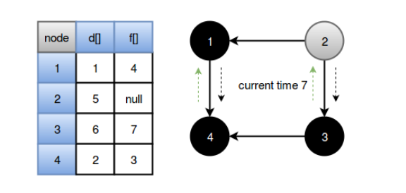
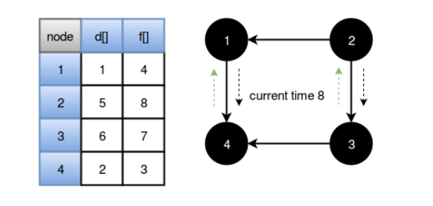

Slide 23
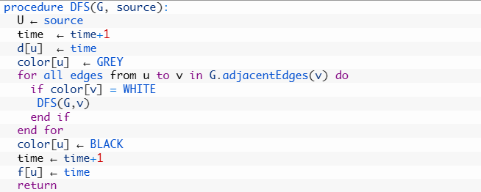
Topological Sorting Algorithm

Slide 24
Fastest Path

Slide 25
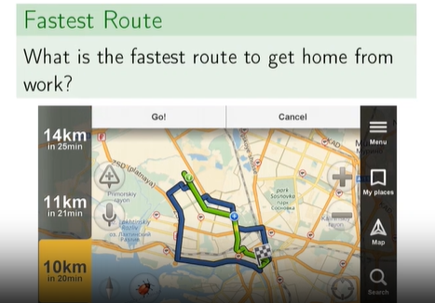
Fastest Route

Slide 26
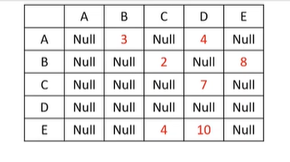
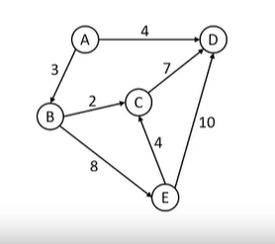
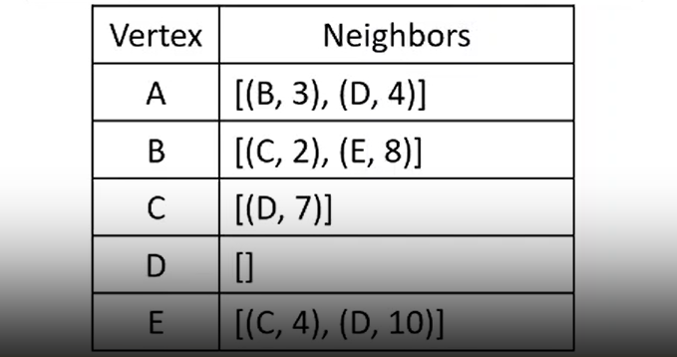
Weighted Directed Graph

Slide 27
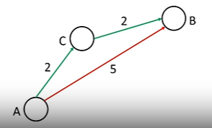
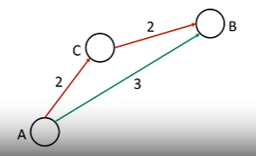
Example:

Slide 28
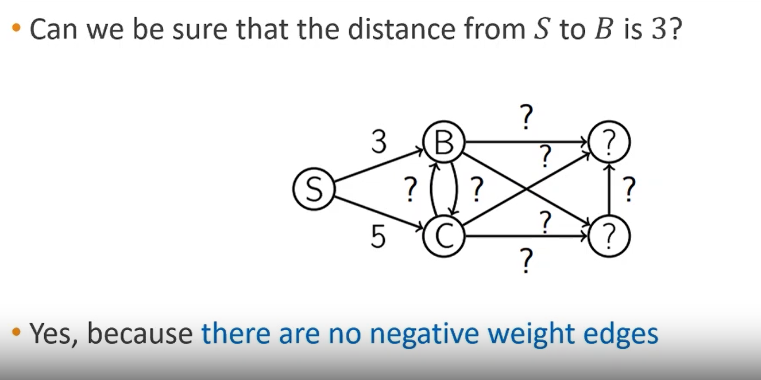

Slide 29
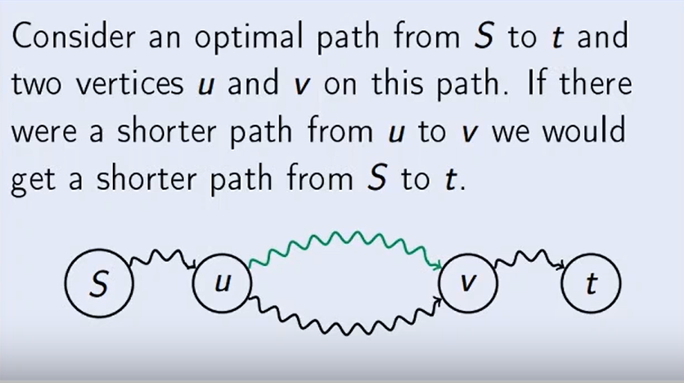
Correctness of Proof:

Slide 30
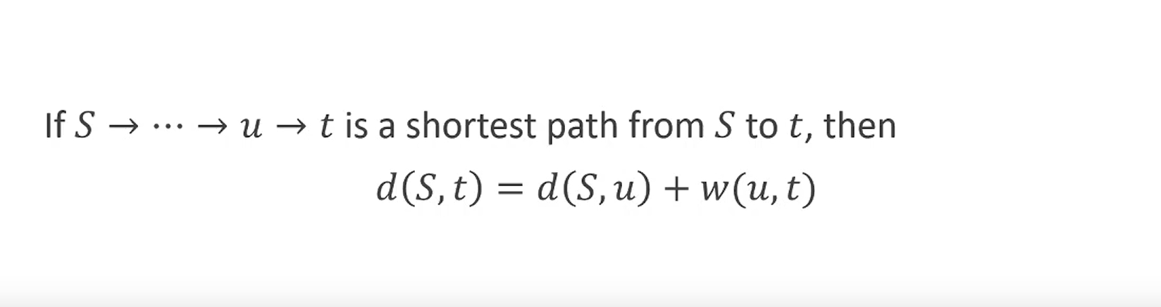

Slide 31
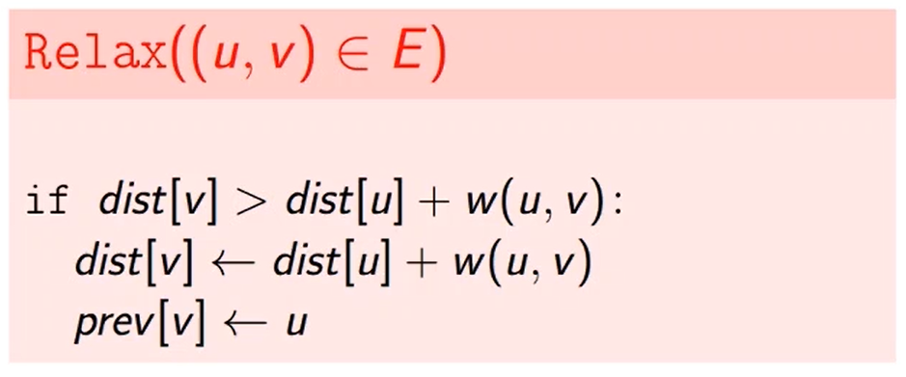
Edge Relaxation
The edge relaxation procedure for an edge (u,v) just checks whether going from S to v through u improves the current value of dist[v]

Slide 32
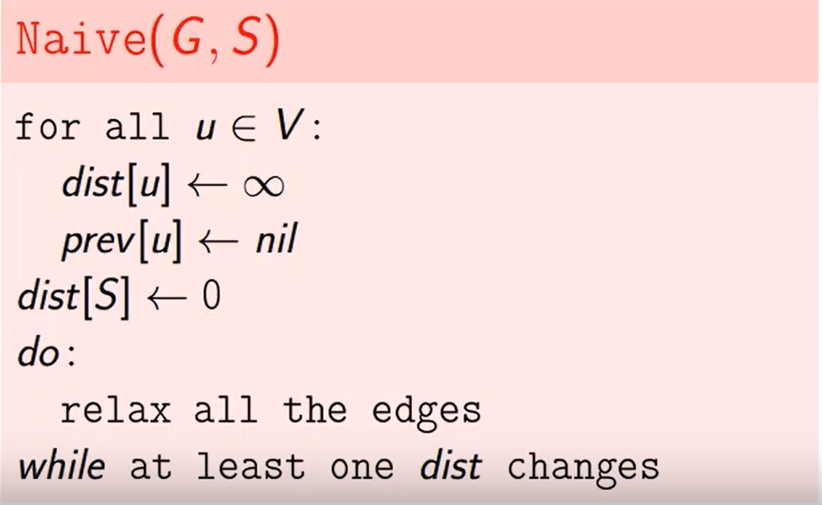
Naïve Approach

Slide 33
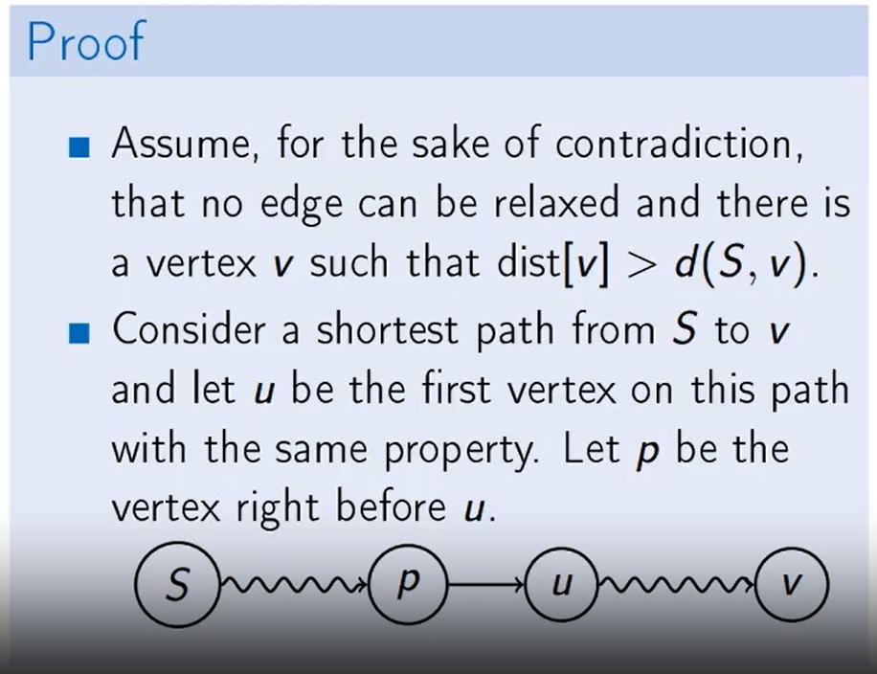

Slide 34
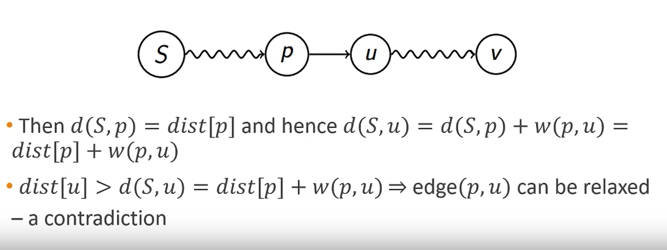

Slide 35
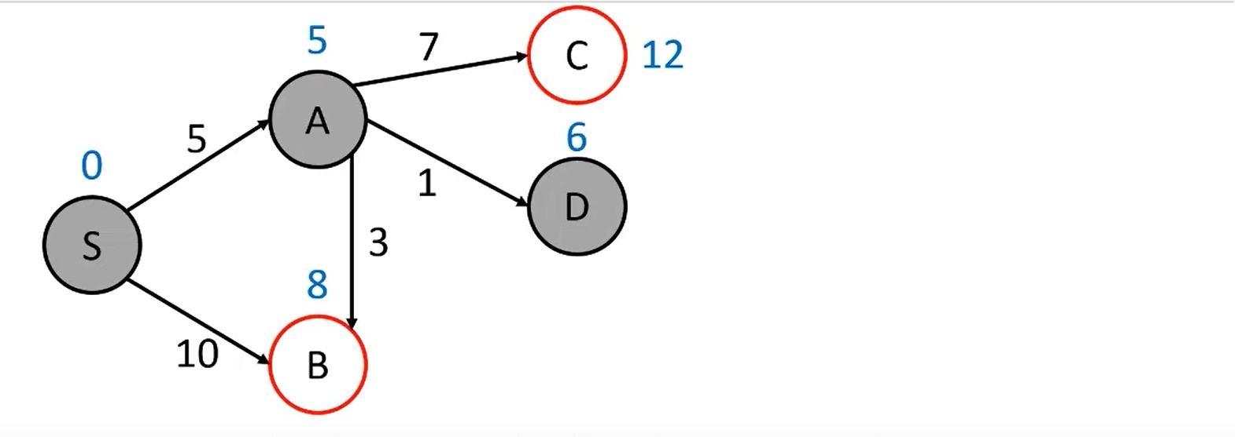
Dijkstra Algorithm

Slide 36
Main Ideas of Dijkstra’s Algorithm
We maintain a set R of vertices for which dist is already set correctly (“known region”)
The first vertex added to R is S
On each iteration we take a vertex outside of R with the minimal dist-value, add it to R, and relax all its outgoing edges.

Slide 37
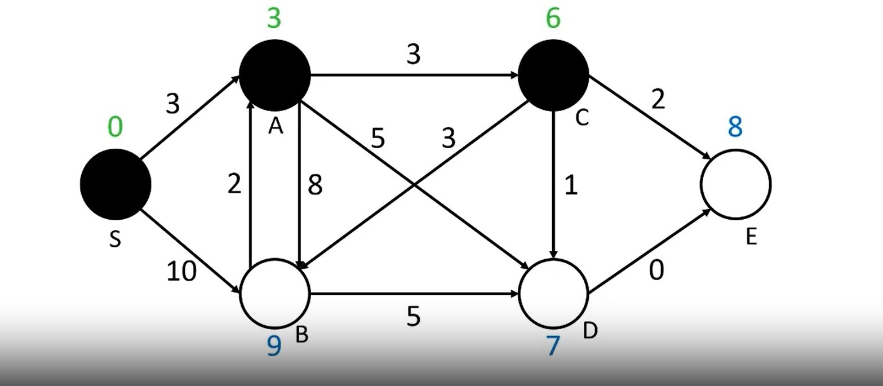
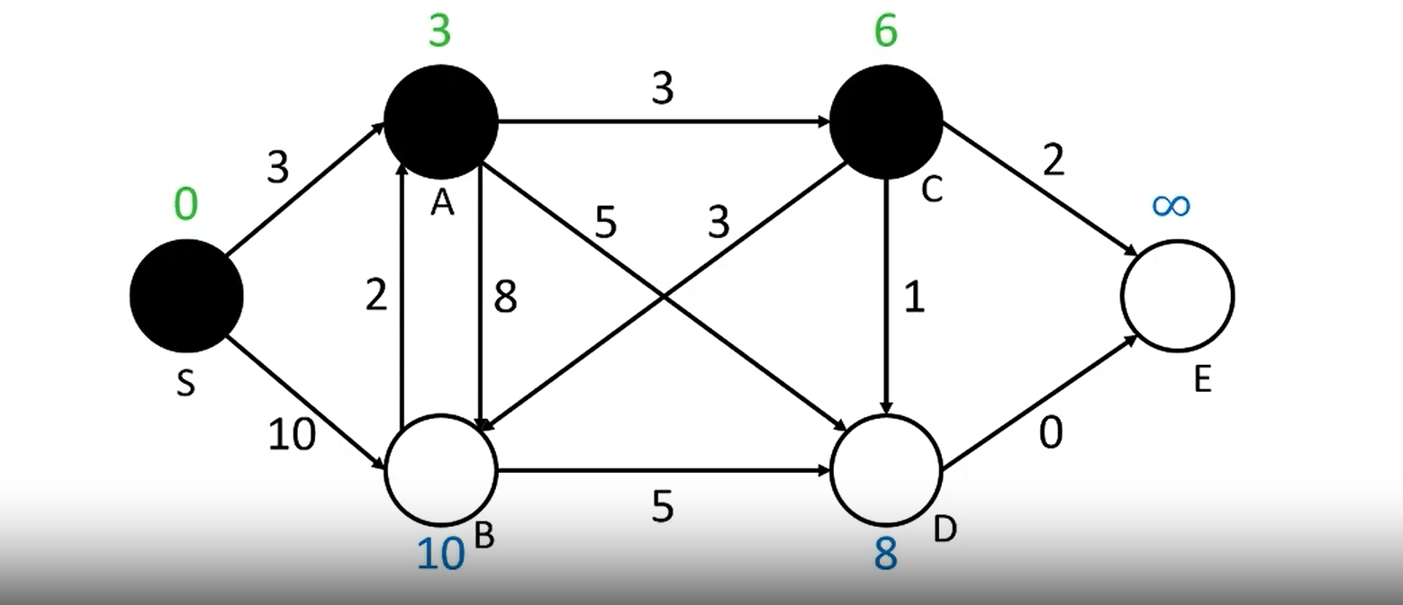
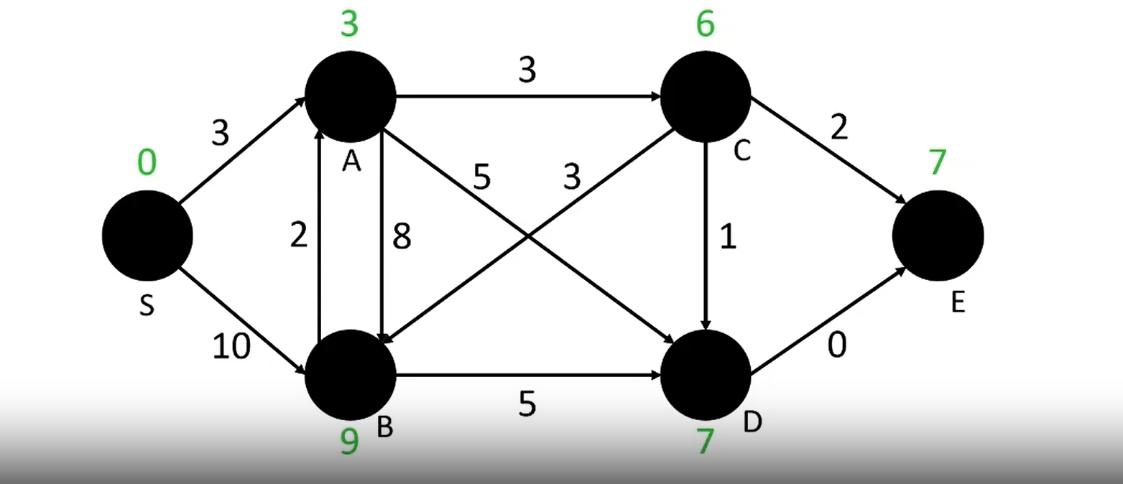
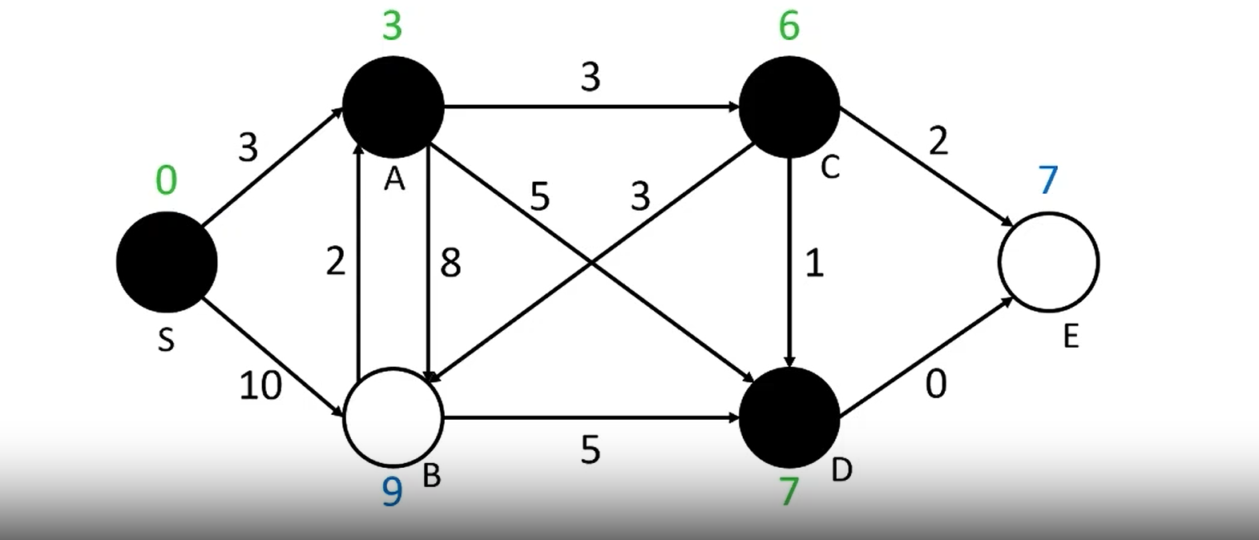
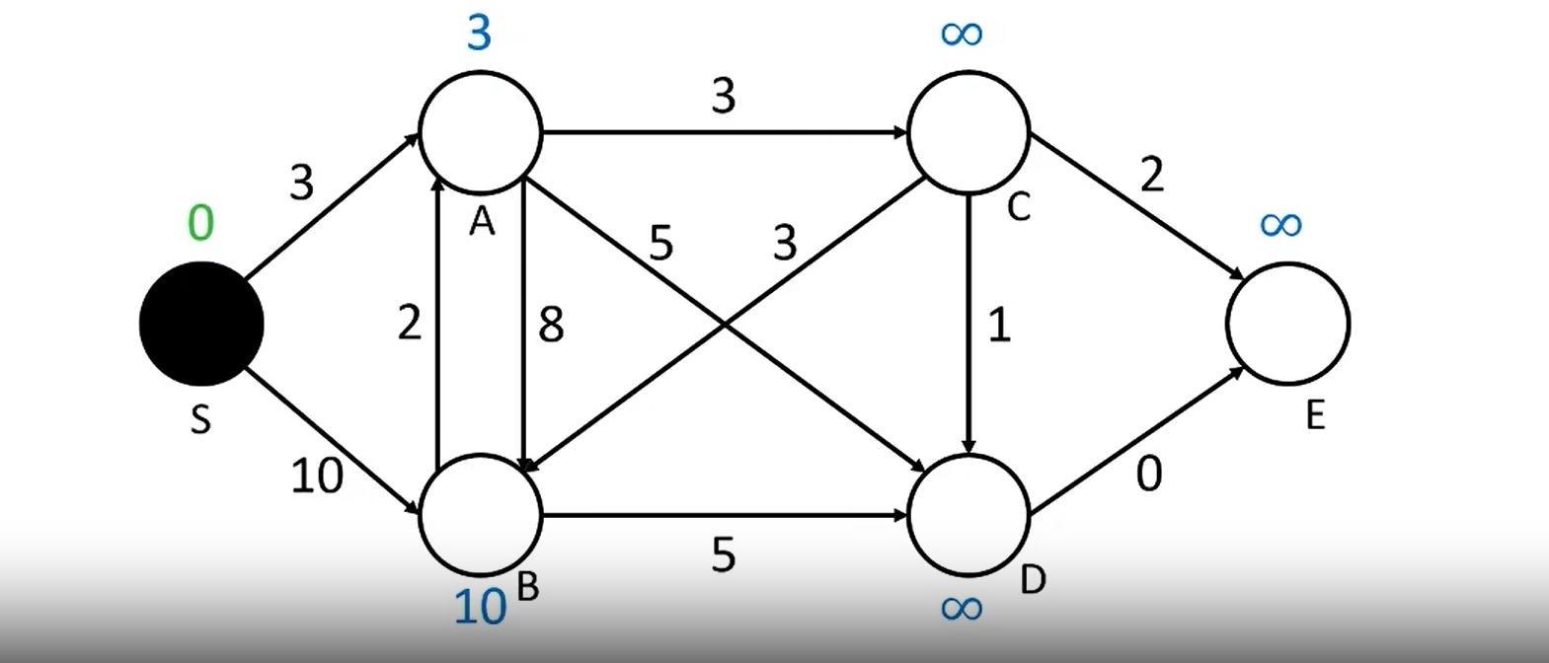
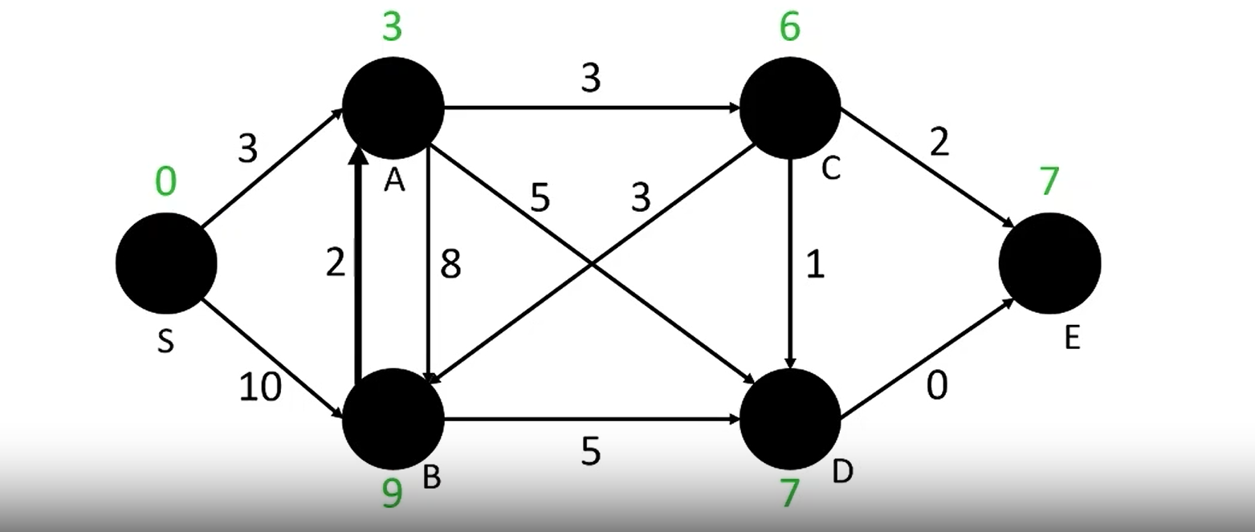
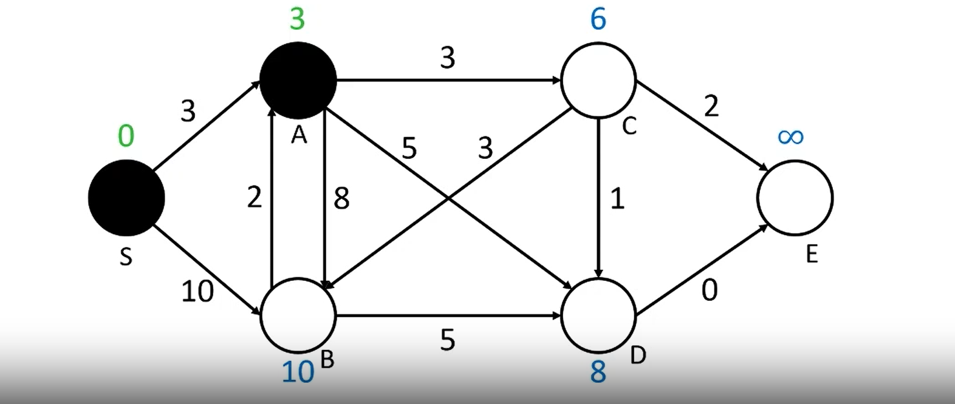
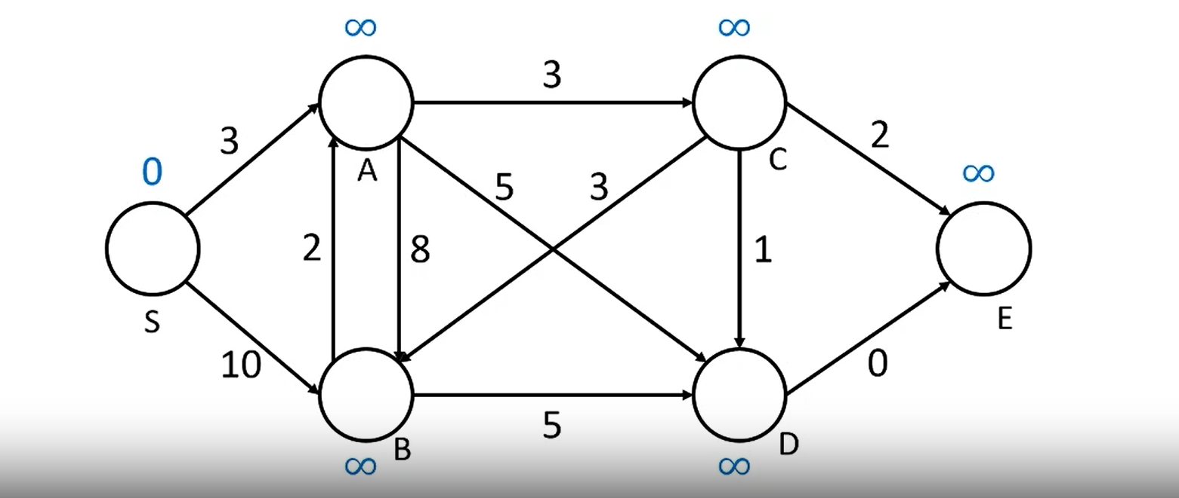
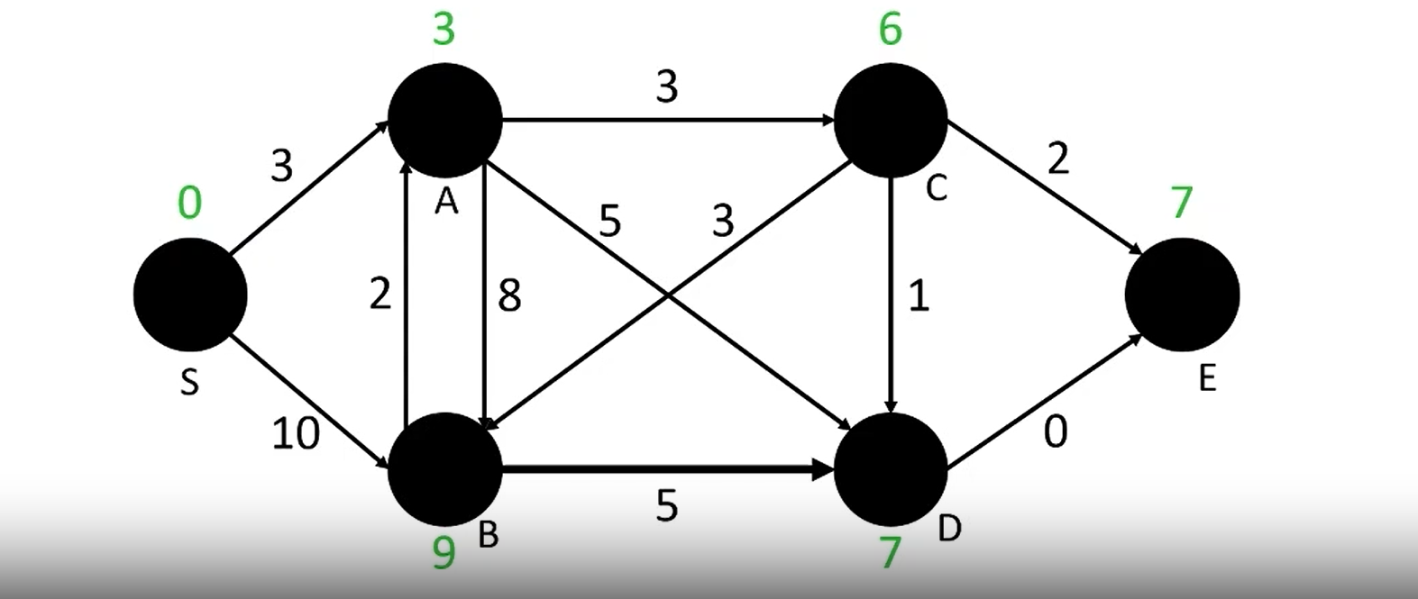
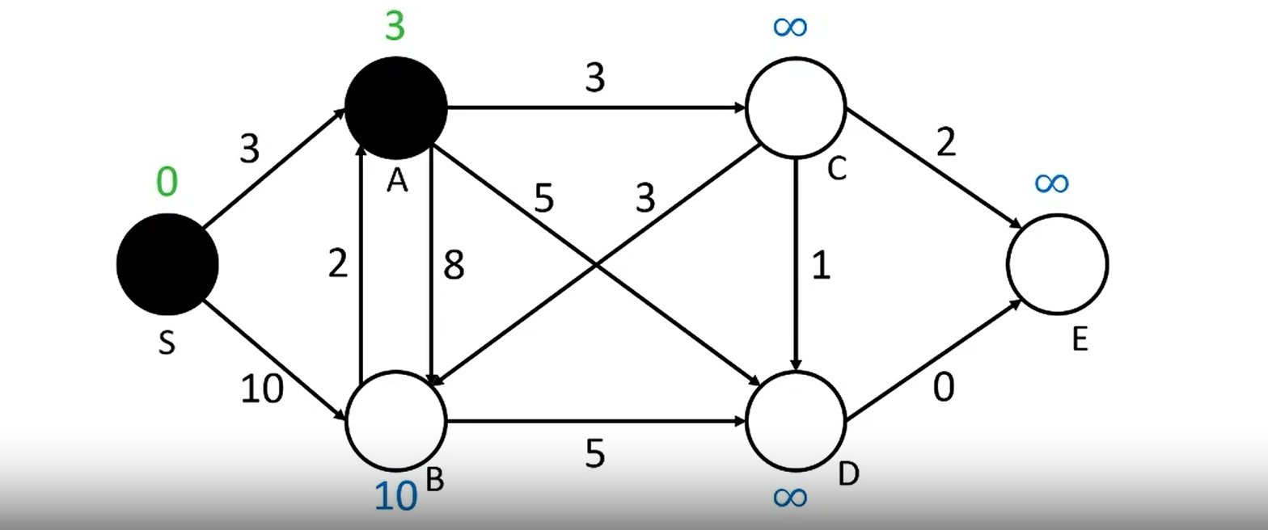

Slide 38
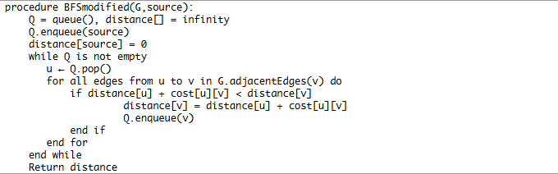
Algorithm – How to implement

Slide 39
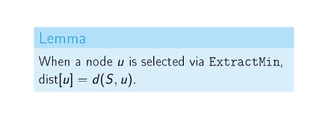
Proof of Correctness

Slide 40
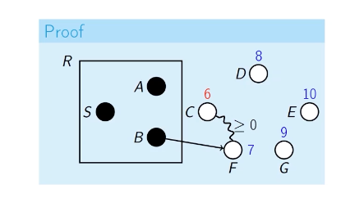
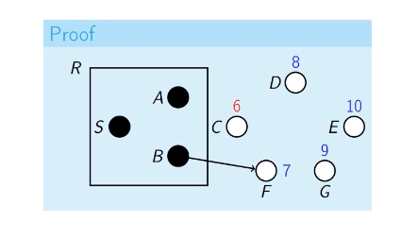
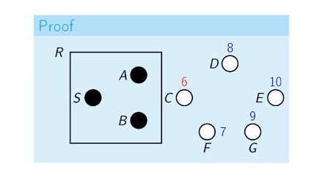
Proof of Correctness

Slide 41
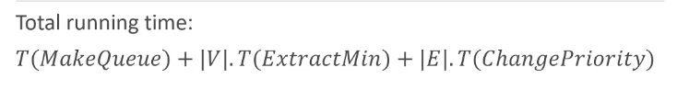

Time Complexity

Slide 42

Dijkstra
Can find the minimum time to get from work to home
Can find the fastest route from work to home
Works for any graph with non-negative edge weights
Works in $O\left(V^{2}\right) or O\left(\left(V+E\right)\log\left(V\right)\right)$ based on implementation

Slide 43


Slide 44
Solution?
Relax edges while dist changes
It works even for negative edge weights

Slide 45

Bellman Ford Algorithm

Slide 46










Bellman Ford Algorithm

Slide 47
Floyd Warshall Algorithm
Floyd Warshall Algorithm is an algorithm for finding the shortest path between all the pairs of vertices in a weighted graph.
This Algorithm works for both the directed and undirected weighted graphs.
But it does not work for the graphs with negative cycles ( Where the sum of the edges in a cycle is negative )
This Algorithm follows the dynamic programming approach to find the shortest paths.

Slide 48












Floyd Warshall Algorithm

Slide 49

Pseudo Code

Slide 50

Time Complexity Analysis
The Floyd Warshall Algorithm operates using three for loops to find the shortest distance between all pairs of vertices within a graph. Therefore, the time complexity of the Floyd-Warshall algorithm is $O\left(n^{3}\right)$, where n is the number of vertices in the graph. The space complexity of the algorithm is $O(n^{2})$.

Slide 51
Minimum Spanning Trees

Slide 52


Definition

Slide 53


Slide 54






Properties of Trees

Slide 55
Properties of Trees

Slide 56
Solution?
Greedy Algorithms??
Yes! There are two greedy algorithms named Kruskals and Prims algorithm for solving minimum spanning trees.

Slide 57
Kruskals Algorithm

Slide 58








Slide 60
Prims Algorithm

Slide 61







